Slide 1
HIERARCHICAL CLUSTERING
Sourav Karmakar
souravkarmakar29@gmail.com

Slide 2
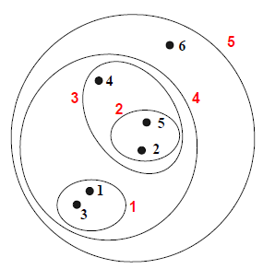
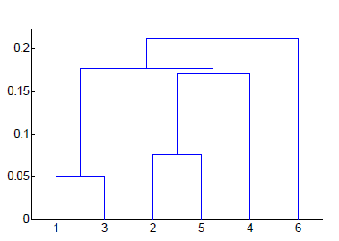
HIERARCHICAL CLUSTERING
Produces a set of nested clusters organized as a hierarchical tree
Can be visualized as a dendrogram : A tree like diagram that records the sequences of merges or splits.
Datapoints
Dendrograms
Strengths of Hierarchical clustering:
Do not have to assume any particular number of clusters : Any desired number of clusters can be obtained by ‘cutting’ the dendrogram at the proper level.
They may correspond to meaningful taxonomies. Example: book cataloguing, biological sciences (e.g. animal kingdom)

Slide 3
HIERARCHICAL CLUSTERING
Two main types of Hierarchical Clustering
Agglomerative: (Bottom Up Approach)
Start with the points as individual clusters.
At each step, merge the closest pair of clusters until you are with only one cluster (or k clusters).
2. Divisive: (Top Down Approach)
Start with one, all-inclusive cluster
At each step, split a cluster until each cluster contains a point (or there are k clusters)
Though both the approaches are perfectly alright in producing quality clusters, people prefer to use Agglomerative approach more than Divisive approach. This is because it is less computationally expensive to deal with smaller clusters as compared to the large all inclusive cluster.

Slide 4
AGGLOMERATIVE CLUSTERING

Slide 5
AGGLOMERATIVE CLUSTERING
Traditional Hierarchical Clustering algorithms use a similarity or distance matrix to split or merge the cluster. This matrix is known as Proximity Matrix.
The basic Agglomerative Clustering algorithm is as following.
Let each data point be a Cluster.
Compute the proximity matrix.
Repeat
Merge the two closest clusters.
Update the proximity matrix.
Until only a single (or K many) cluster remains. (K is user provided number of clusters)
Different approaches on defining the distance / proximity between two clusters distinguishes different algorithms. However the basic algorithm as shown above is followed everywhere in Agglomerative clustering.

Slide 6
AGGLOMERATIVE CLUSTERING
How to define inter-cluster Distance / Proximity ?
Following are the different ways to define the inter-cluster distance / proximity.
MIN or Single Linkage
MAX or Complete Linkage
Group Average
Distance Between Centroids
We shall now briefly discuss these methods.

Slide 7
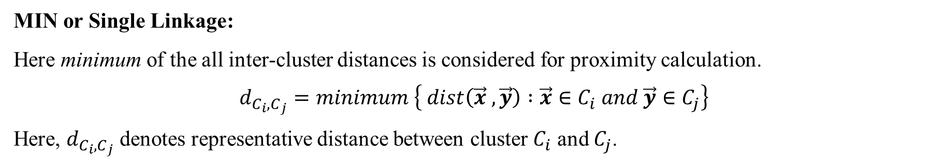
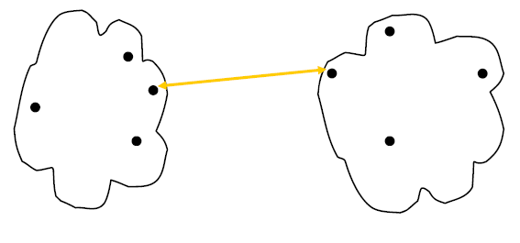
AGGLOMERATIVE CLUSTERING

Slide 8
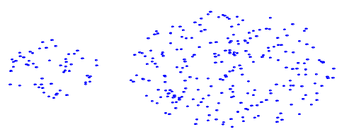
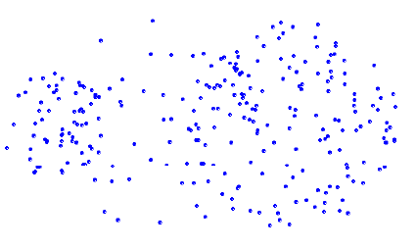
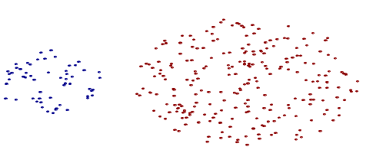
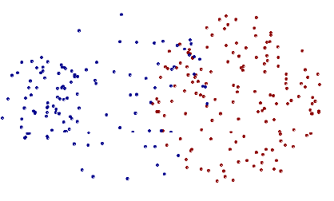
AGGLOMERATIVE CLUSTERING
Strength of MIN or Single Linkage
Limitation of MIN or Single Linkage
Original Points
Original Points
Clustered Points
Clustered Points
Single Linkage can handle shapes of different sizes
Single Linkage is susceptible to noise and outliers

Slide 9
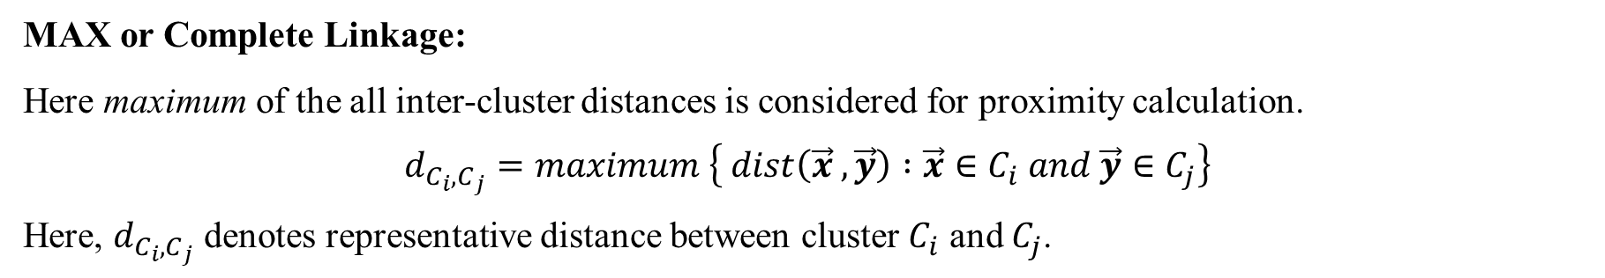
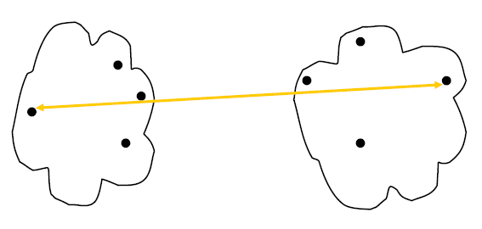
AGGLOMERATIVE CLUSTERING

Slide 10
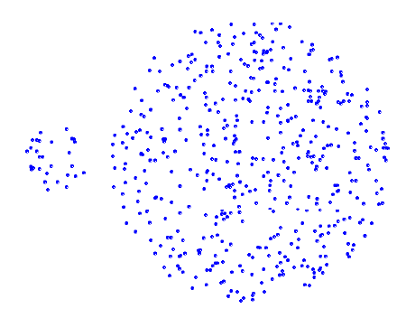
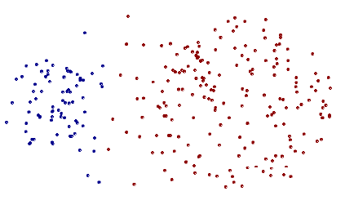
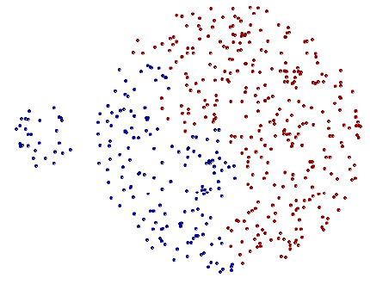
AGGLOMERATIVE CLUSTERING
Strength of MAX or Complete Linkage
Limitation of MAX or Complete Linkage
Original Points
Original Points
Clustered Points
Clustered Points
Complete Linkage is less susceptible to noise
Complete Linkage tends to break large clusters

Slide 11
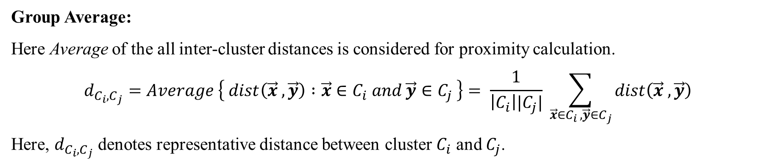
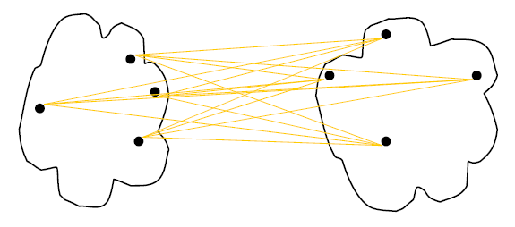
AGGLOMERATIVE CLUSTERING

Slide 12
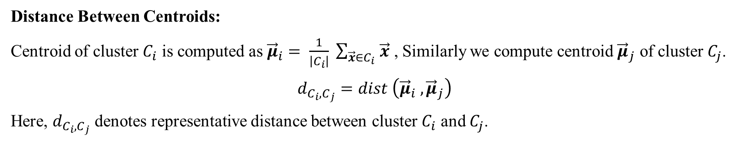
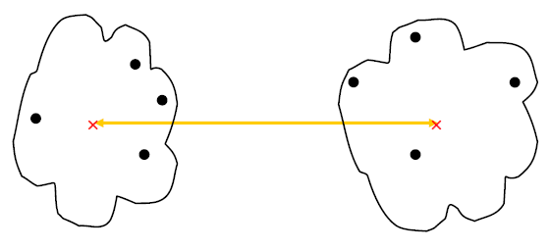
AGGLOMERATIVE CLUSTERING

Slide 13
Thank You

